Slide 1

Lecture-6
Policy Gradients & Actor Critic Algorithms

Slide 2
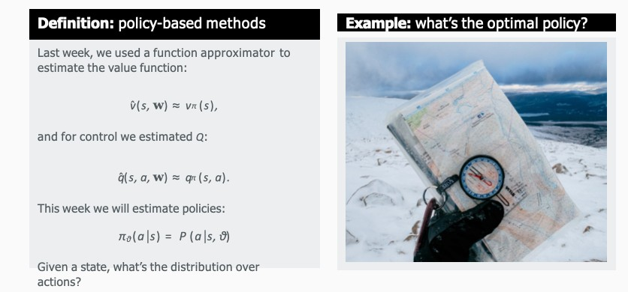
Policy-based methods

Slide 3
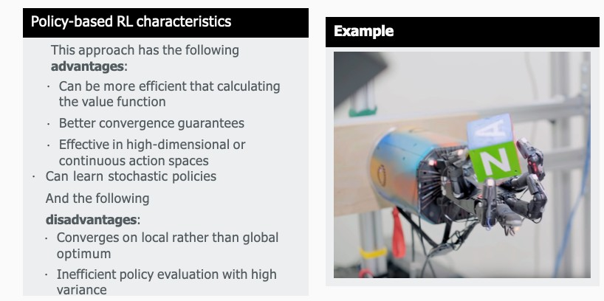
Policy-based methods- characteristics

Slide 4
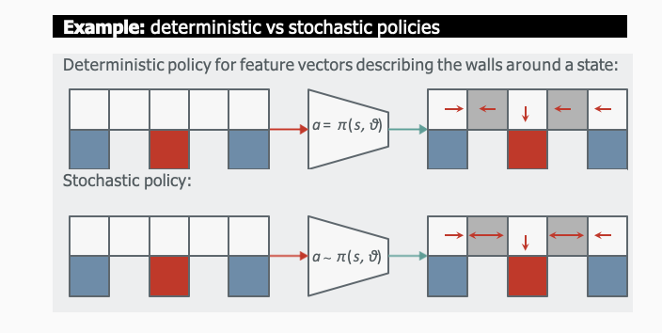
Policy-based methods(deterministic vs stochastic policies)

Slide 5
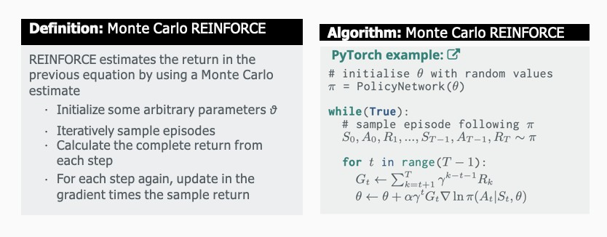
Policy-based methods(Monte Carlo Reinforce)

Slide 6
REINFORCE belongs to a special class of Reinforcement Learning algorithms called Policy Gradient algorithms. A simple implementation of this algorithm would involve creating a Policy: a model that takes a state as input and generates the probability of taking an action as output. A policy is essentially a guide or cheat-sheet for the agent telling it what action to take at each state. The policy is then iterated on and tweaked slightly at each step until we get a policy that solves the environment.
The policy is usually a Neural Network that takes the state as input and generates a probability distribution across action space as output.

Slide 7
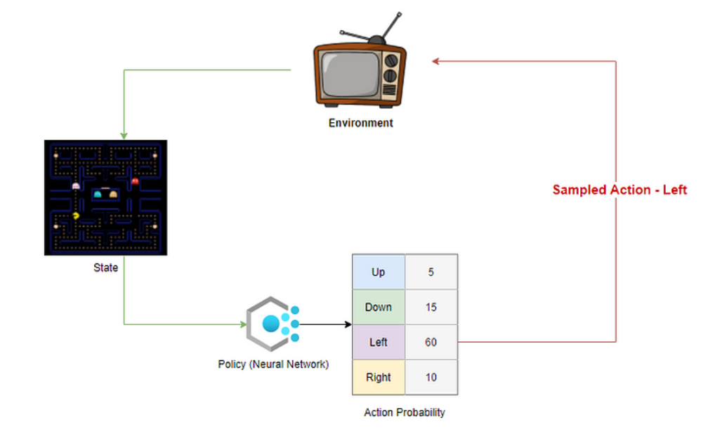

Slide 8
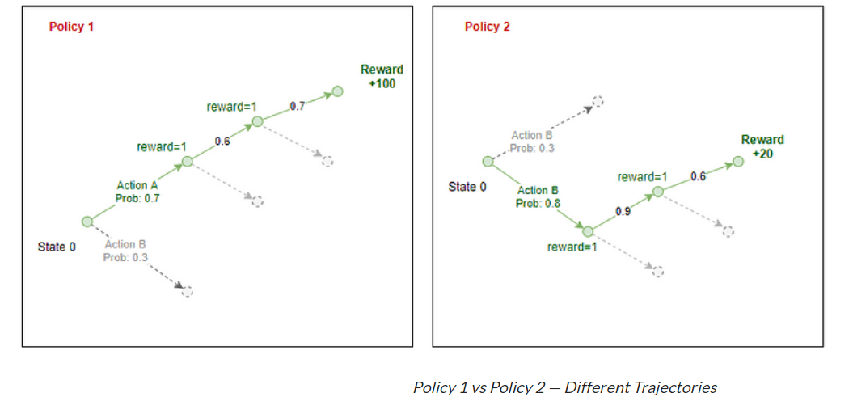
Each policy generates the probability of taking an action in each station of the environment.

Slide 9
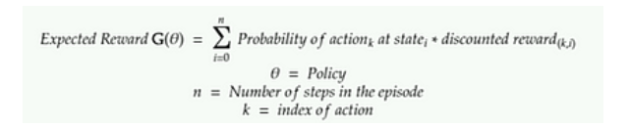
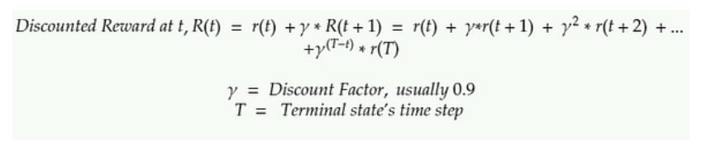

Slide 10
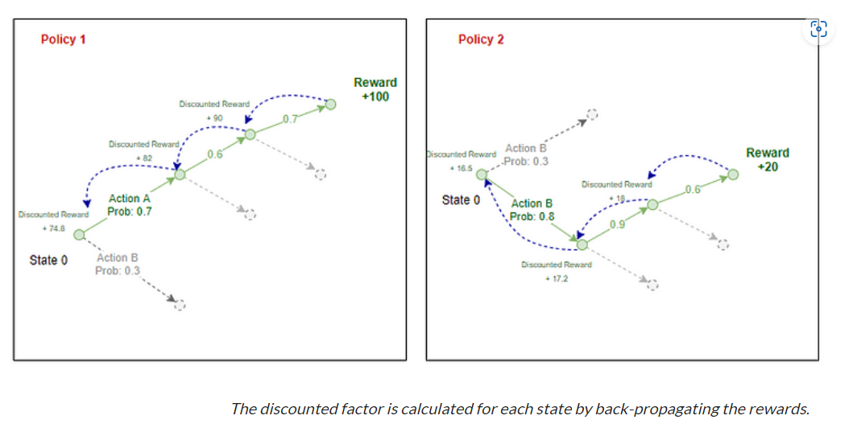

Slide 11
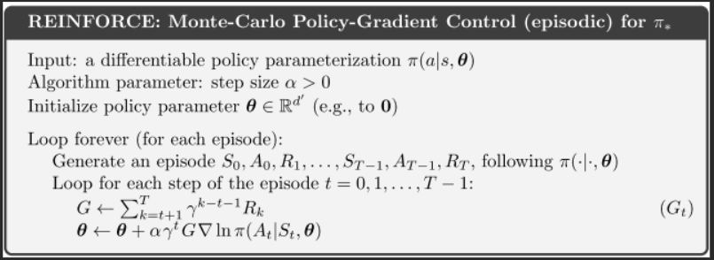
Reinforce Algorithm

Slide 12
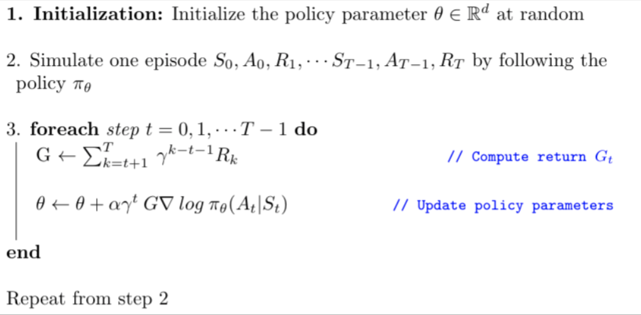

Slide 13
Actor Critic Algorithm
The actor critic algorithm consists of two networks (the actor and the critic) working together to solve a particular problem. At a high level, the Advantage Function calculates the agent’s TD Error or Prediction Error. The actor network chooses an action at each time step and the critic network evaluates the quality or the Q-value of a given input state. As the critic network learns which states are better or worse, the actor uses this information to teach the agent to seek out good states and avoid bad states.

Slide 14
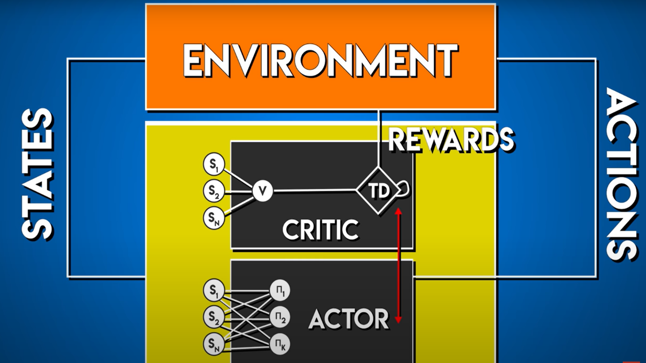
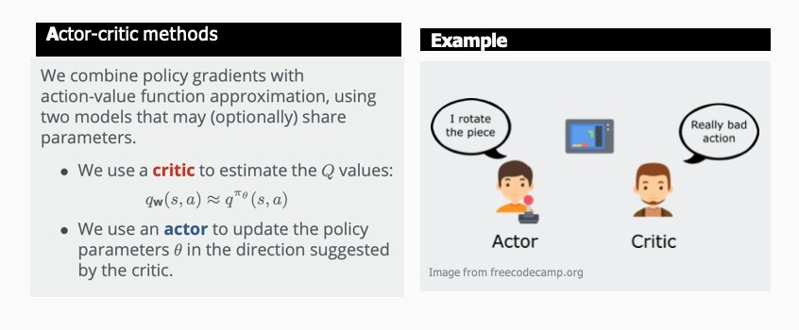
Actor Critic Methods

Slide 15
Advantage Function
The Advantage function tells us if a state is better or worse than expected. If an action is better than expected (the advantage is greater than 0), we want to encourage the actor to take more of that action. If an action is worse than expected (the advantage is less than 0), we want to encourage the actor to take the opposite of that action. If an action performs exactly as expected (the advantage equals 0), the actor doesn’t learn anything from that action.

Slide 16
In the Advantage Actor Critic algorithm, the Advantage is equal to the TD Error.

Slide 17

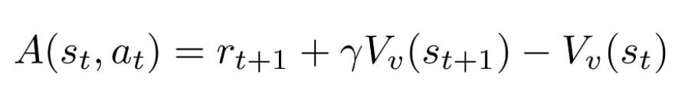
Advantage Function

Slide 18
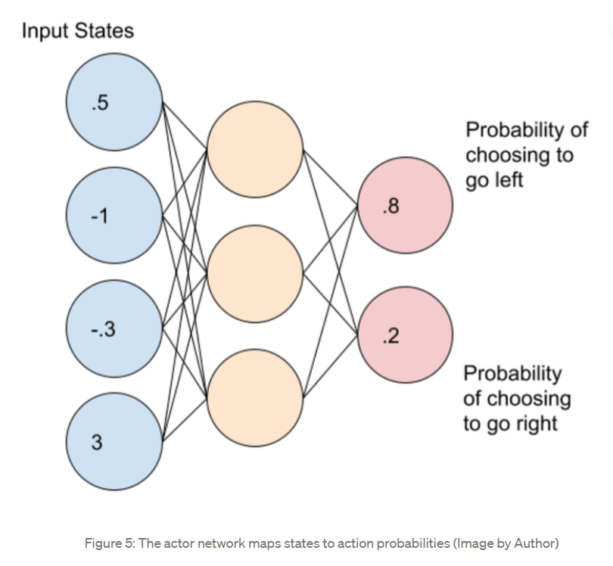
Actor-Network

Slide 19
The actor network outputs a probability distribution corresponding to each action.
We sample actions from this probability distribution according to each action’s probability.
If the action to go left has a value of .8 and the action to go right has a value of .2, we will only choose the left action 80% of the time and the right action 20% of the time. Because the output is a probability distribution, note that the agent will not always choose the action with the highest probability.

Slide 20
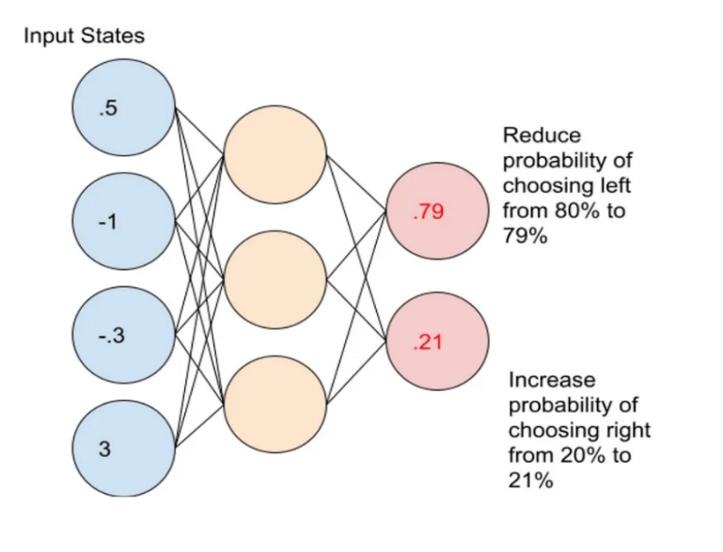
Updating the Actor Network’s weights

Slide 21
In this case, the agent wants to reduce the probability of choosing left from 80% to 79%.
Likewise, the agent needs to increase the probability of choosing right from 20% to 21%.
After updating these probabilities, we can update our network weights by fitting the network to the new probabilities.

Slide 22
How does the algorithm decide which actions to encourage and which to discourage?
The A2C algorithm makes this decision by calculating the advantage.
The advantage decides how to scale the action that the agent just took.
Importantly the advantage can also be negative which discourages the selected action. Likewise, a positive advantage would encourage and reinforce that action.

Slide 23
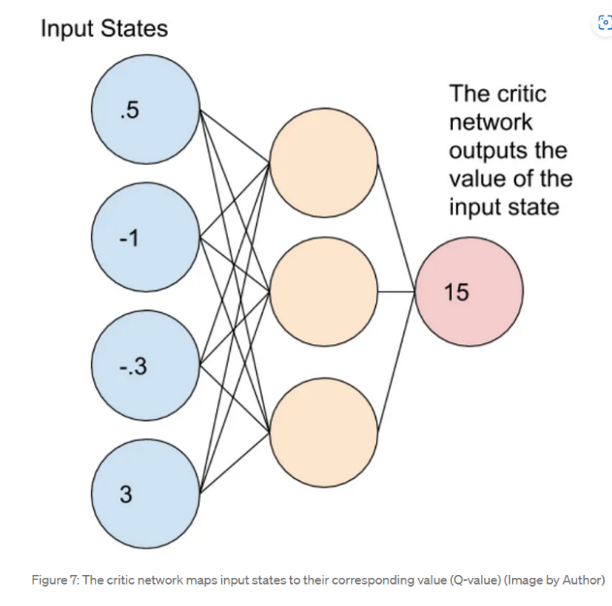
Critic Network

Slide 24
The critic network maps each state to its corresponding Q-value. The Q-value represents the value of a state where Q represents the Quality of the state.
Unlike the Actor Network which outputs a probability distribution of actions, the Critic Network outputs the TD Target of the input state as a floating point number.

Slide 25
Updating Critic Network Weights
As the TD Error approaches 0, the Critic Network gets better and better at predicting the outcome from the current state.
In this case, we want to drive the TD Error as close to 0 as possible.
In order to update the critic network weights, we use the Mean Squared Error of the TD Error function.

Slide 26
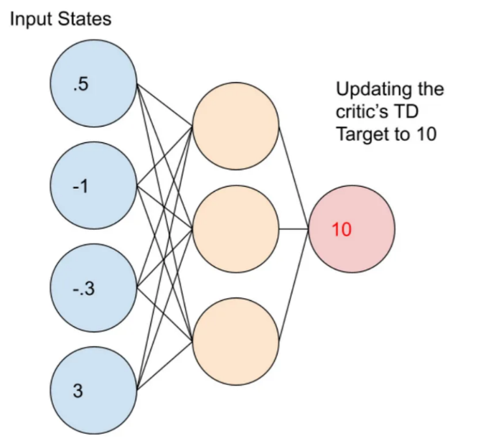
Critic Update

Slide 27
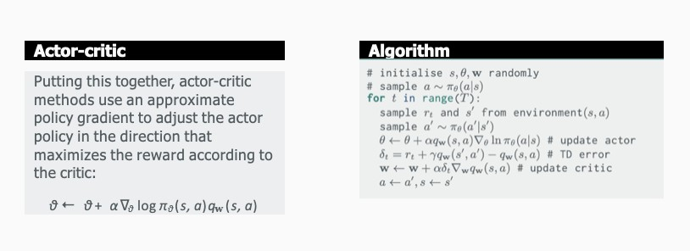
Actor Critic Method Algorithm

Slide 28
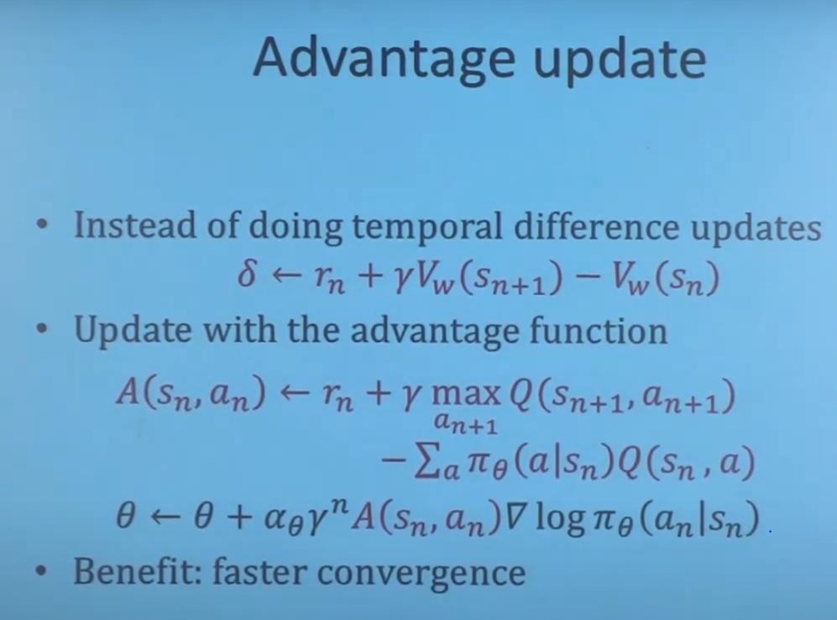

Slide 29
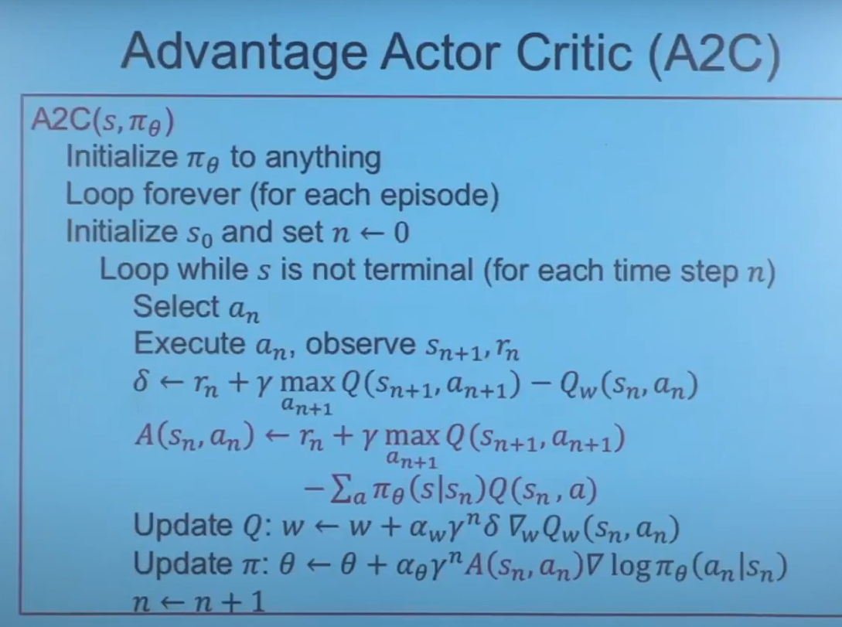

Slide 30

Extensions(papers to read)
This has introduced the foundations, hopefully now you have a good platform to read about the extensions to this.
Recommended further study (papers & code): Recommended further study (theory & STAR):
Recommended extensions include:
Advantage actor critic (A3C & A2C)
Experience replay & prioritized replay
Proximal policy optimization
Rainbow (combining extensions)

Slide 31
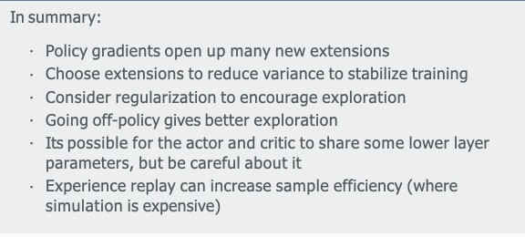
Summary

Slide 32
References/Resources
•
Richard S Sutton and Andrew G Barto.
Reinforcement learning: An introduction (second edition). Available online I. MIT press, 2018.
•
John Schulman et al. “Proximal policy optimization algorithms”. In: arXiv preprint
arXiv:1707.06347 (2017).
•
Ronald J Williams. “Simple statistical gradient-following algorithms for connectionist
reinforcement learning”. In: Machine learning 8.3-4 (1992), pp. 229–256.

Slide 33
References/Resources
•
Volodymyr Mnih et al. “Asynchronous methods for deep reinforcement learning”. In:
International conference on machine learning. 2016, pp. 1928–1937.
•
Ziyu Wang et al. “Sample efficient actor-critic with experience replay”. In: arXiv preprint
arXiv:1611.01224 (2016).

